Slide 1
Cancer Statistics 2016
A Presentation from the
American Cancer Society
©2016, American Cancer Society, Inc.

Slide 2
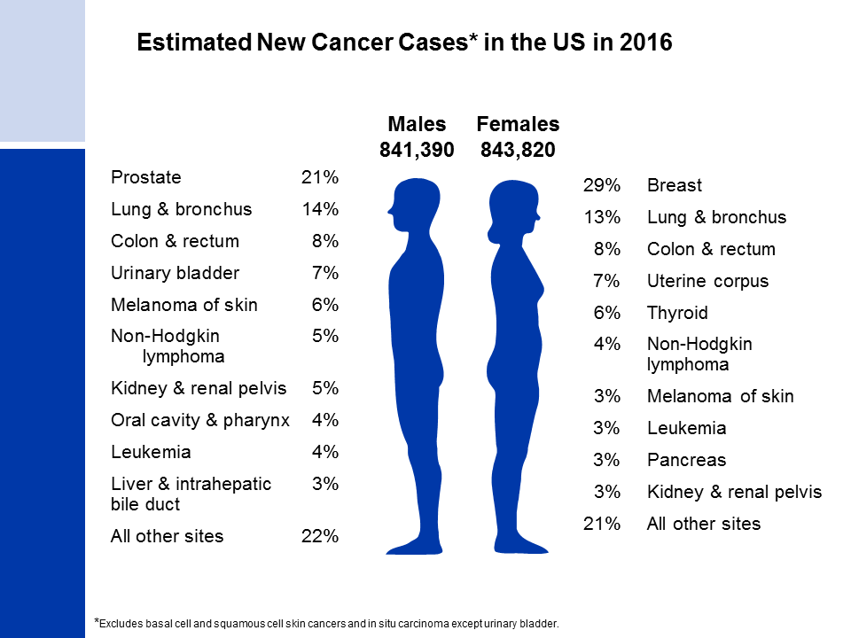
Notes:
It is estimated that almost 1.7 million new cases of cancer will be diagnosed in 2016. Prostate cancer is the most common cancer among males (21%), followed by lung (14%) and colorectal (8%) cancers. Among females, breast (29%), lung (13%), and colorectal (8%) cancers are the most common.

Slide 3
Notes:
This slide shows trends in cancer incidence rates for all sites combined from 1975 to 2012. The current cancer incidence rate (averaged over 2008-2012) is about 20% lower in females than in males. The reasons for this are not well understood, but likely reflect differences in environmental and hormonal exposures. During the most recent 10 years of data, rates declined by 1.4% per year in males and were stable in females. The decrease among males is attributed mainly to declines in prostate, lung, and colorectal cancers.
The 9 oldest SEER registries represent approximately 9% of the US population and are the only source for long-term (since 1975) population-based incidence data.

Slide 4
Notes:
Incidence rates of prostate cancer have changed substantially over the past 20 years: rapidly increasing from 1988 to 1992, declining sharply from 1992 to 1995, remaining stable from 1995 to 2000, and decreasing (on average) from 2000 to 2012, with a marked decrease between 2011 and 2012. This erratic trend primarily reflects changing patterns in the utilization of prostate-specific antigen (PSA) blood testing for the detection of asymptomatic prostate cancer. Incidence rates for both lung and colorectal cancers in males have been declining for more than two decades, whereas rates for liver and thyroid cancers and melanoma are increasing.

Slide 5
Notes:
Breast cancer incidence rates in females have been relatively stable since 2004, after decreasing 7% from 2002 to 2003, primarily due to a reduction in use of hormone replacement therapy. Lung cancer rates began to decline in the mid-2000’s after increasing since at least 1975. Differences in the lung cancer pattern between males and females reflect later smoking uptake and slower cessation among the latter. Colorectal cancer incidence rates have been declining since the mid-1980s. In contrast, incidence rates are increasing for cancers of the liver, thyroid, and uterine corpus.

Slide 6
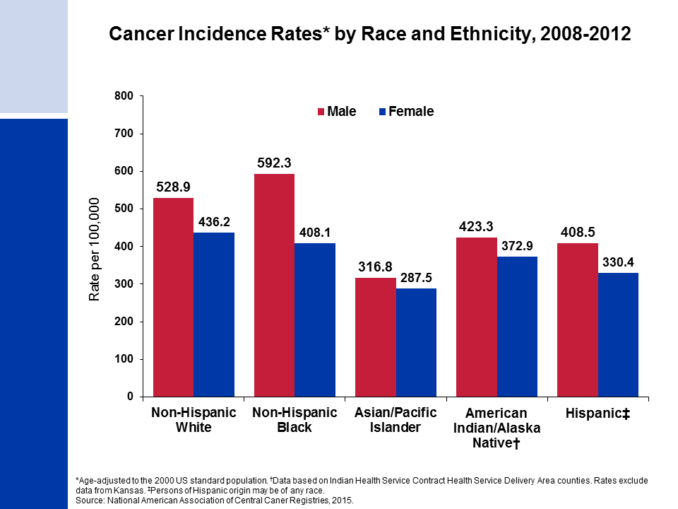
Notes:
Cancer incidence rates are higher in males than in females for each racial/ethnic population. The highest incidence rates are in blacks among males and in whites among females. Asian/Pacific Islanders have the lowest rates in both sexes.
It is important to note that rates for populations other than white and black individuals may be underestimated due to incomplete information on race/ethnicity in medical records.

Slide 7
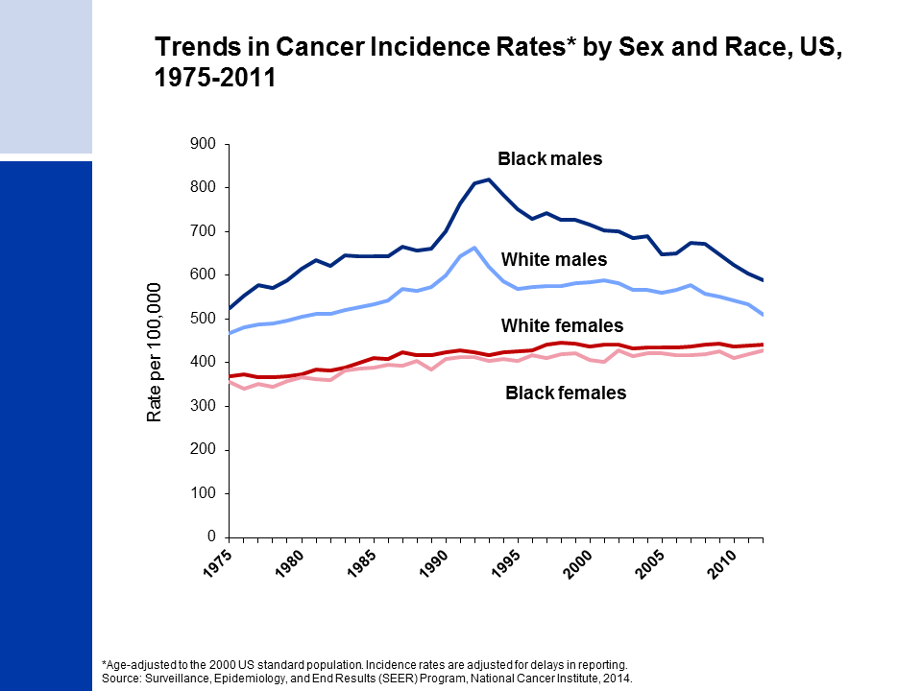
Notes:
Since the mid-1970s, cancer incidence rates for all sites combined have been substantially higher among black than white males, while among females rates are similar but are slightly higher in whites. The higher rates among white compared to black females has been driven by lung and breast cancers; however, breast cancer incidence rates in these two groups converged in 2012.

Slide 8
Notes:
The next four slides look at the lifetime probability of developing cancer and cancer survival.
For American males, the average lifetime risk of developing cancer is one in two, or 42%. These figures are based on the entire male population and vary for individuals because of lifestyle and other factors. For example, cancer risk among smokers is higher than among nonsmokers.

Slide 9
Notes:
The risk of an American woman developing cancer over her lifetime is one in three, or 38%.

Slide 10
Notes:
There have been notable improvements in survival rates for most cancer types due to earlier detection and/or advances in treatment. For example, due to improvements in treatment, the five-year relative survival rate for leukemia has increased from 34% in the mid-1970s to 62% in the most recent time period.

Slide 11
Notes:
While gains in survival have occurred for both whites and blacks, blacks have lower survival rates than whites for most cancer types. The largest differences are for cancers of the oral cavity and uterus. Factors that contribute to racial disparities in survival include a later stage of diagnosis among blacks, as well as a lower likelihood of receiving high quality treatment. Additional factors include differences in tumor characteristics unrelated to early detection and differences in the prevalence of comorbidities (other health conditions).

Slide 12
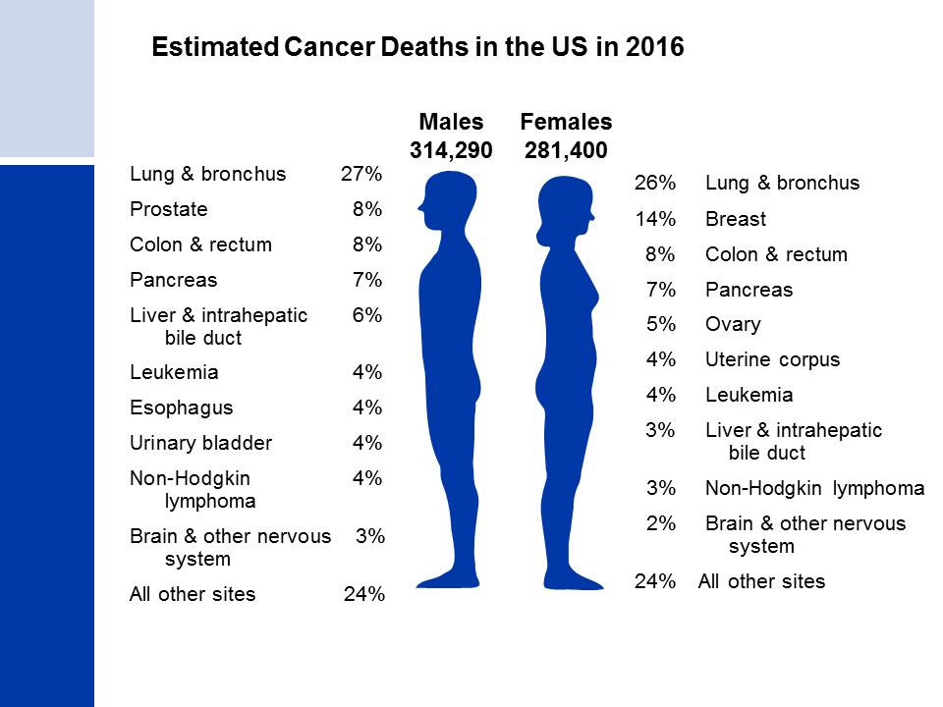
Notes:
Now we will turn our attention to cancer mortality. Lung cancer is by far the leading cause of cancer death among males (27%), followed by prostate (8%) and colorectal (8%) cancers. Among females, lung (26%), breast (14%), and colorectal (8%) cancers are the leading causes of cancer death.

Slide 13
Notes:
Cancer death rates have been declining in males and females since the early 1990s. From 1991 to 2012, the combined death rate dropped 23%. Over the past 10 years (2003 to 2012), the death rate for all cancers combined decreased by 1.8% per year in males and 1.4% per year in females.

Slide 14
Notes:
Prior to 1990, most of the increase in the male cancer death rate was attributable to the rapid increase in lung cancer deaths due to the tobacco epidemic. However, since 1990, the lung cancer death rate in males has been decreasing; this decline accounts for about 40% of the overall decrease in cancer death rates in males. The death rate for stomach cancer, which was the leading cause of cancer death among males early in the 20th century, has decreased by more than 90% since 1930. Death rates for prostate and colorectal cancers have been declining since the early 1990s and 1980s, respectively. In contrast to declining death rates for most cancers, liver cancer death rates increased by about 3% per year from 2003 to 2012, and death rates for pancreatic cancer have also been increasing slightly.

Slide 15
Notes:
The lung cancer death rate in females began declining in the early 2000s after increasing for the previous 70 years. As for incidence, the later decline in lung cancer in females compared to males reflects the lag in both smoking uptake and cessation in females. Breast cancer death rates changed little between 1930 and 1989, but decreased 36% from 1989 to 2012. As in males, the death rate for stomach cancer has decreased by more than 90%. Also similar to males, liver cancer death rates increased by about 2% per year from 2003 to 2012, and pancreatic cancer death rates also increased slightly. In contrast to males, colorectal cancer death rates have been decreasing for more than 60 years. Uterine corpus cancer death rates (shown in the inset) have been increasing since 2000, similar to the increase in incidence.

Slide 16
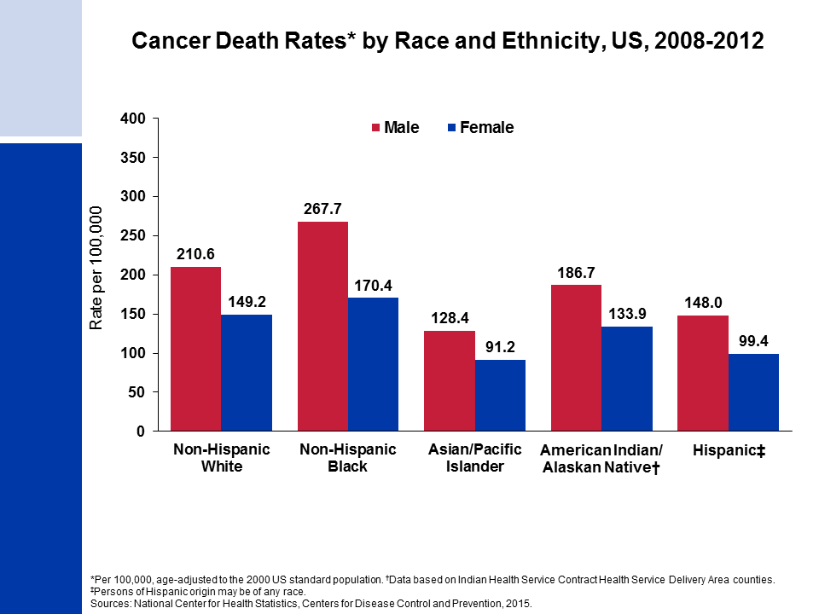
Notes:
Cancer death rates are higher among males than among females for every racial and ethnic group. Black males and females have the highest cancer mortality rates and Asian/Pacific Islanders have the lowest, about half the rates of blacks.
It is important to note that rates for populations other than white and black may be underestimated due to incomplete information on race/ethnicity in medical records.

Slide 17
Notes:
Although the overall cancer death rate continues to be highest among black men, they have had the largest relative decline -- 38% from 1990 to 2012, compared to 26% in white males, 21% in black females, and 18% in white females.

Slide 18
Notes:
More than 1.7 million cancer deaths were averted as a result of two decades of consistent declines in cancer deaths rates.

Slide 19
Notes:
The next series of slides present the burden of cancer among children and adolescents in the US. Since 1975, cancer incidence rates among children and adolescents 0-19 years have been increasing slightly by about 0.6% per year. In contrast, cancer death rates in both children and adolescents decreased by more than half from 1975 to 2012.

Slide 20
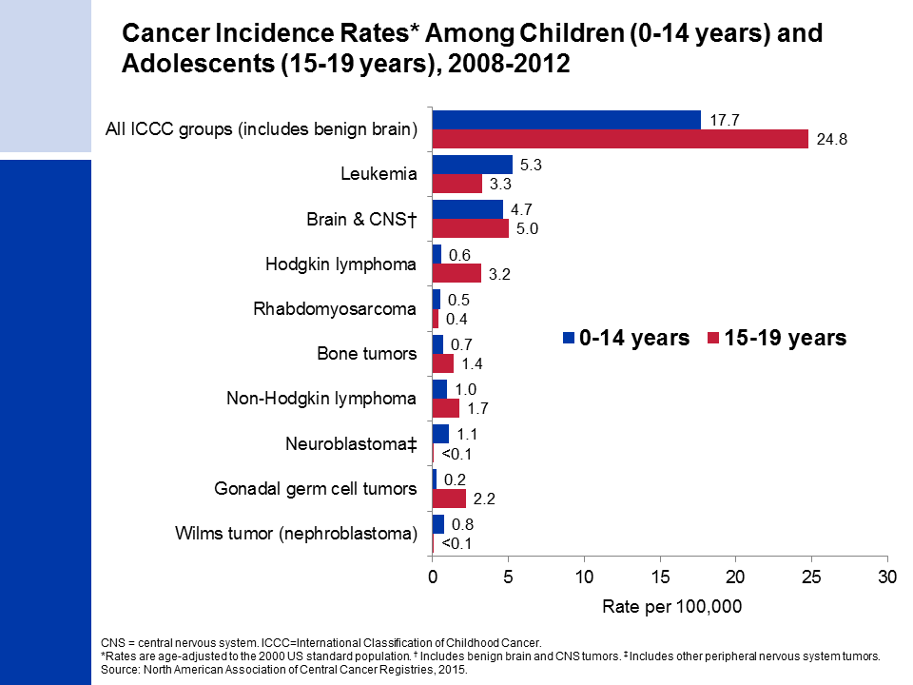
Notes:
The cancers presented in this slide are grouped according to the International Classification of Childhood Cancers because this system categorizes cancers based on a combination of both histology (microscopic structure) and tumor location, rather than location alone, which is more appropriate for cancer in children. Leukemia accounts for about 30% of all cancers diagnosed in children, but just 13% of cancers diagnosed in adolescents.
Cancer registries were mandated by law to begin reporting benign and borderline malignant brain and central nervous system tumors on January 1, 2004. Reporting was expanded to include these cancers because benign tumors cause disruption to normal function similar to malignant tumors and because the location of a brain tumor is as important as whether it is benign or malignant in terms of prognosis. Approximately one-third of all brain tumors diagnosed in children and adolescents from 2008 to 2012 were benign or borderline malignant.

Slide 21
Notes:
The top causes of childhood and adolescent cancer death are similar, but they rank differently. The most common cause of cancer death in children is brain and other nervous system tumors, followed closely by leukemia. In adolescents, leukemia ranks first, followed by brain and other nervous system.
The reason that leukemia is a more common cause of cancer death in adolescents than in children, despite having a lower incidence rate, is because survival rates for leukemia are higher in children than adolescents, whereas survival for brain and other nervous system is lower in children than in adolescents (as is shown on the next slide).

Slide 22
Notes:
Survival rates are similar for children and adolescents overall, but are different for some cancer sites. For example, the current 5-year relative survival rate for leukemia is 85% for children but only 72% for adolescents.

Slide 23
Notes:
The 5-year relative survival rate for childhood cancer has increased significantly during the past 3 decades. For example, the 5-year survival for childhood and adolescent leukemia patients has improved from 45% for those diagnosed in the mid 1970s to 85% in the most recent time period. Because of the large strides in treatment for leukemia, brain cancer has surpassed leukemia as the leading cause of cancer death among ages 0-19 years combined.

Slide 24
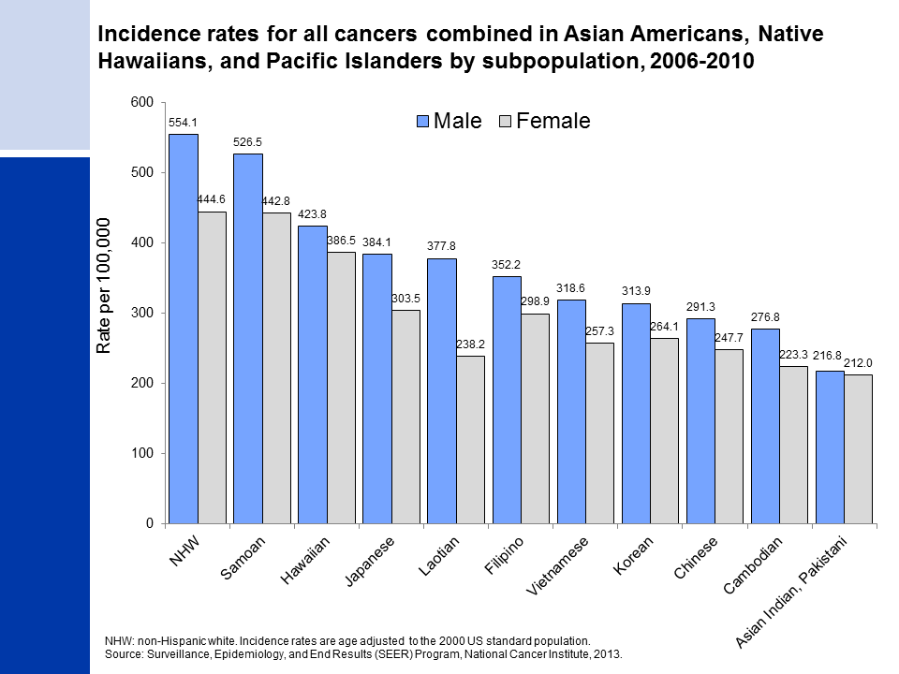
Notes:
The special section of Cancer Facts & Figures 2016 focuses on cancer occurrence in Asian Americans, Native Hawaiians, and Pacific Islanders (AANHPI). Although AANHPIs have the lowest overall cancer incidence and mortality rates in the US compared to other major racial and ethnic groups, aggregate AANHPI rates mask important differences within this heterogeneous population. For example, incidence rates for Samoans, which approach those for non-Hispanic whites, are more than double those of Asian Indians and Pakistanis.
Variation in overall cancer incidence among AANHPI subpopulations is driven primarily by differences in underlying incidence rates for lung, prostate, and female breast cancers, reflecting differences in the prevalence of risk factors.

